Slide 1


CPU DESIGN PROJECT

Slide 2
CONTENTS
WHAT IS CPU?
WHAT DID WE DO IN THE PROJECT?
SYSTEM ARCHITECTURE FOR CPU
FINAL PART
TEST BENCHES

Slide 3
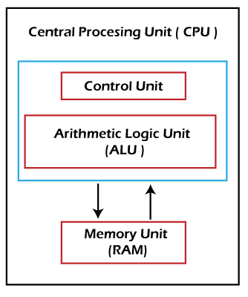
WHAT IS CPU?
CPU is short for Central Processing Unit. It is also known as a processor or microporcessor.
Inside a CPU there are thousands of microscopic transistors, which are tiny switches that control the flow of electricity through the integrated circuits.
You'll find the CPU located on a computer's motherboard.
In a nutshell, a CPU is responsible for handling the processing of logical and mathematical operations (addition, subtraction, etc.) and executing instructions that it is given.

Slide 4
WHAT DID WE DO IN THE PROJECT?
We actively used all the information we learned during the semester. In the face of the problems we encountered, we produced solutions depending on the gains we achieved in the course and realized the processor design given.

Slide 5
SYSTEM ARCHITECTURE FOR CPU
We used the Avionchip company’s verilog description language tool for our processor design, so we had the opportunity to simulate our processor on the system without the need for an FPGA.

Slide 6
FINAL PART
We have added a control mechanism to our processor.With this control mechanism, we checked whether the appropriate resultwas added tothe position in the memory requested from us or whether an incorrect operation wasperformed. We have achieved this control with the memChechk function.

Slide 7
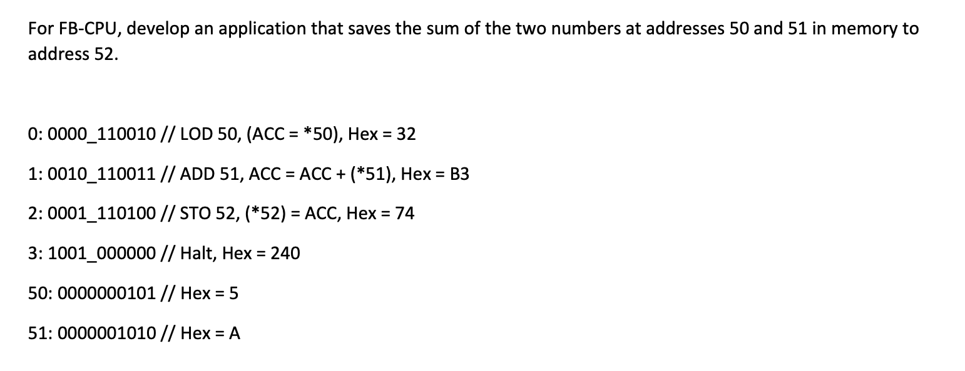
TEST CASE 1

Slide 8
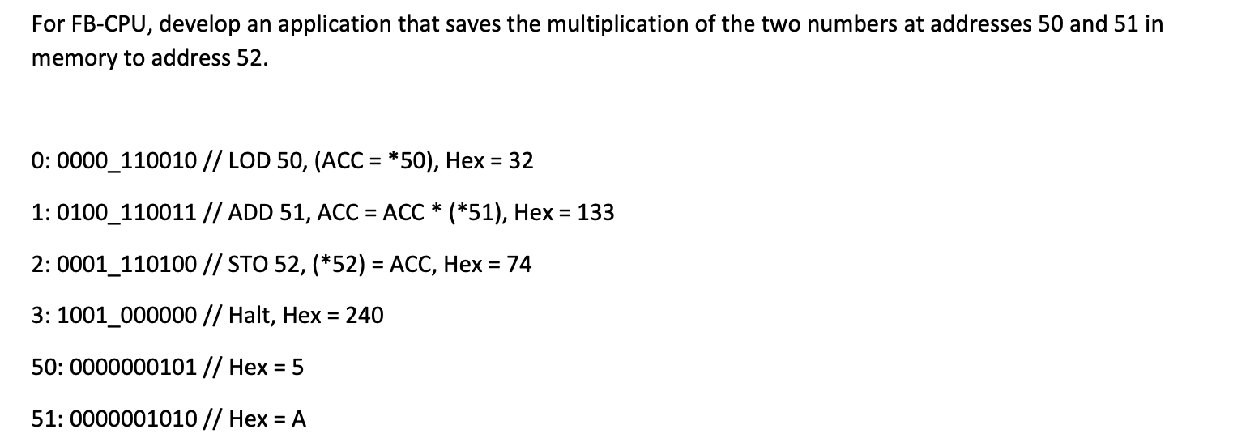
TEST CASE 2

Slide 9
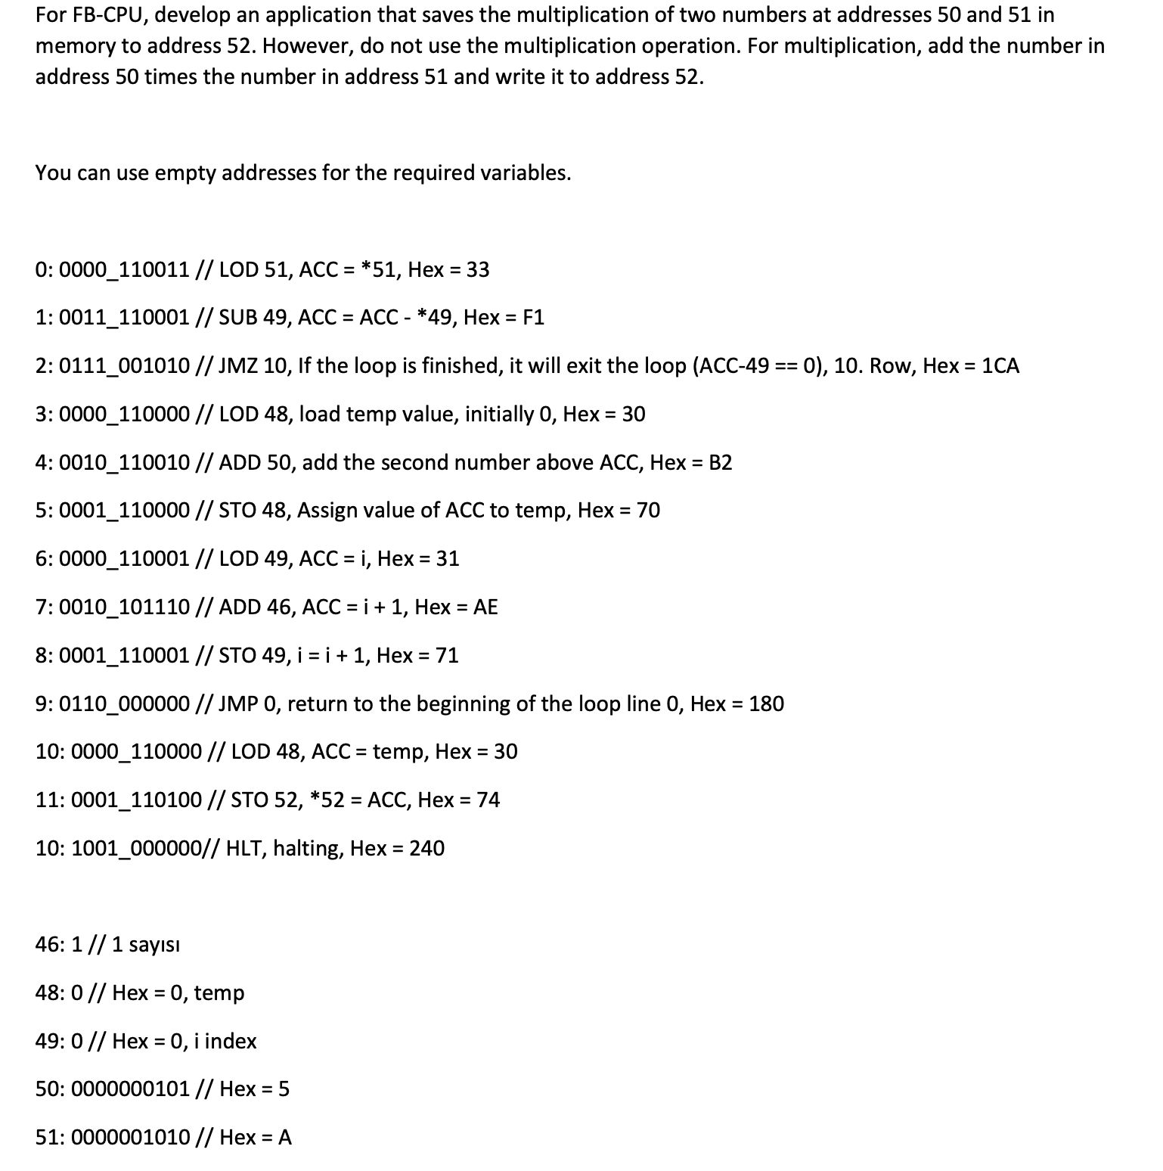
TEST CASE 3

Slide 10
MEMCHECK FUNCTION
task memCheck;
input [31:0] memLocation, expectedValue;
begin
if(blram.memory[memLocation] != expectedValue) begin
error = 1;
end
end
endtask

Slide 11
PROJECT GROUP
AYŞE İREM ÇOLAK
210304001
HİLAL ASYA AKBAŞ
220304012
AZİZ BURAK KAÇAR
210304042
EMRE MERCAN
210304015
MERT SARI

Slide 12
RESOURCES
http://www.levent.tc/files/courses/digital_design/lectures/lec10/BLM201_hafta10_fb_cpu.pdf
http://www.levent.tc/files/courses/digital_design/project/BLM201_proje_spesifikasyonlari.pdf
https://www.mcu-turkey.com/wp-content/uploads/2013/12/islemci_tasarimi_ve_asamalari-1.pdf
https://stringfixer.com/tr/Microprocessor_design
https://en.wikipedia.org/wiki/Arithmetic_logic_unit
https://www.britannica.com/technology/arithmetic-logic-unit

